Slide 1
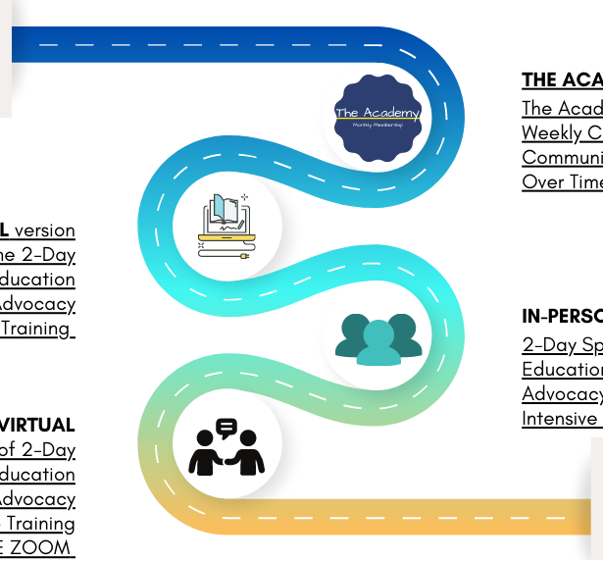


Trade Waste Officer Pathway
NZC in Trade Waste (Consent and Compliance) Water (NEW)
Direct entry.
Evidence of workplace activities is required.
Who: persons who are in a Trade Waste Officer role and have responsibilities of trade waste consenting and compliance and responsible for managing the interface of trade waste on wastewater operations.
Focus is on management and control of consenting and compliance and management of the interface between wastewater producers and wastewater treatment operators.
Trade Waste Micro credential (Level 5) (TBC)
Who: persons who are seeking the skills and knowledge to understand the fundamentals of policy formation and the regulation response, and to assess and provide recommendations on policy effectiveness.

