Slide 1
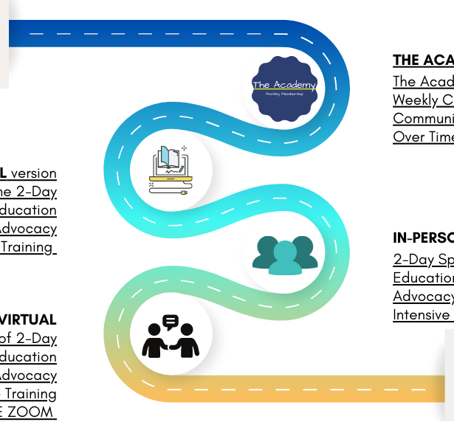


Drinking water supply micro-credentials (Level 3)
Three Drinking Water Micro credentials (Level 3) (NEW)
Working with small on-site drinking water supply
Purpose: Provides individuals with foundational skills and knowledge to safely operate a small onsite water system, to ensure safety and sufficiency of drinking water supply, meet compliance requirements and understand duty of care.
Who: For persons people who are operating small onsite water systems.
NZC in Water Services (Pre-Trade) with strands in DW and WW (NEW)
Potential to pathway into the water services industry. See Drinking Water Treatment Operator Pathway.
Who: persons interested in water as a career and those who are new to water.
Fundamentals covered
Sciences and mathematics.
Regulatory framework, standards, duty of care, stewardship of the wai
Principles of water (DW strand).
Drinking water sampling and compliance
Purpose: Provides individuals with foundational skills and knowledge to carry out sampling with an understanding of compliance requirements.
Who: Regional councils, lab staff, all operators, small supply, schools, and some sectors e.g tourism, housing developments, agricultural
Introduction to Water
Purpose: Provides individuals with foundational knowledge to recognise the principles of water, and the regulatory environment.
Who: For persons who work alongside the water services industry, and for regional councils, lab staff, all operators, small supply, schools, trade waste officers, and some sectors e.g tourism, housing developments, agricultural

