Slide 1
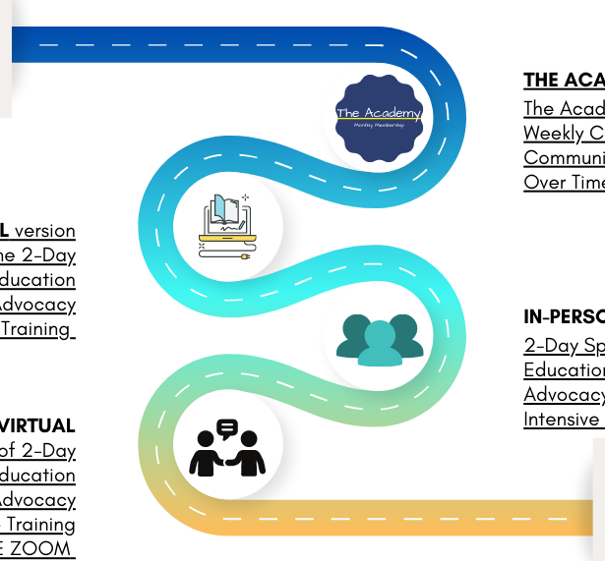




Wastewater Plant Operator Pathway
NZC in Water Services with strands in DW and WW (NEW)
Highly recommended as a pathway into Level 4
Evidence of workplace activities not required
Who: persons interested in water as a career and those who are new to water.
Fundamentals covered
Sciences and mathematics
Regulatory framework, standards, duty of care, stewardship of the wai
Strands in DW and WW
NZC in Wastewater Plant Operations with strands by treatment process type (NEW)
Direct entry or pathway in from Level 3 (highly recommended)
Evidence of workplace activities is required.
Who: persons who are in an operator role with sole charge or soon to have in-charge responsibilities of day-to-day operations.
Focus is on management and control of treatment operations with emphasis on applied knowledge, critical thinking, and problem-solving.
Multistage strand removed and replaced with specific treatment processes. These are unbundled, enabling the leaner and employer to ‘select’ relevant processes for enrolment.
There is no ‘credit cap’ on selection enabling a learner to enrol in any of the treatment process strands.
Apprenticeship model (120 credits at Level 4) plus optional strand credits.
Wastewater Micro credentials (Level 4) (NEW)
Standalone micro credentials each focused on a specific treatment process
Who: persons who move to a new operating environment where they are being exposed to other treatment processes OR for operators who are needing to introduce new/additional treatment processes and need to upskill team.
NZ Diploma in Water Services with strands (REPLACEMENT/NEW)
Direct entry but is required to meet pre-requisites where it may be stated on a strand
Focus is on planning/forecasting, optimising, monitoring, and management of water services.

Slide 2
Wastewater Plant Operator Level 3 and 4 qualification content
NZC in Water Services (Level 3)
with strands in DW and WW (NEW)
NZC in Wastewater Plant Operations with strands by treatment process type (NEW)
The purpose of this qualification is to provide the water industry with individuals who have foundational skills and knowledge to work in entry-level roles in the water services industry.
This qualification is stranded to recognise the specific skills relevant to drinking and wastewater.
Graduates of this qualification will be able to:
Manage health and safety in everyday water services tasks
Complete sampling, testing, and reporting
Apply fundamental maths and science
Identify relationships between water services industries
Recognise the relevance of legislation, regulations, and compliance requirements
Graduates of the drinking water strand will have skills and knowledge in:
Water sources
Drinking water treatment processes
Consequences of incorrect operation
Graduates of the wastewater strand will have skills and knowledge in:
Wastewater sources
Wastewater treatment processes
Consequences of incorrect operation
The purpose of this qualification is to provide the wastewater treatment industry with individuals who are able to be responsible for the day-to-day control of wastewater treatment processes, and operation of a wastewater treatment plant.
This qualification is stranded to recognise the skills required for the operation of various treatment processes.
Graduates of this qualification will be able to:
Control treatment processes
Isolate and recommission process components
Recognise the integration between systems
Apply maths and science to operations
Communicate and lead/work with a team
Comply with legislative and compliance requirements, including DWS plan
Respond to emergencies or incidents
Identify and manage wastewater sources
Manage discharge
Graduates can complete as many optional strands as are relevant to their treatment plant, including in:
Preliminary processes
Separation
Sludge treatment and management
Activated sludge
Effluent disinfection and land application
Filtration
Fixed growth reactor
Nutrient removal

