Slide 1

Worker support practice toolkit
Construction and
Infrastructure sector:
Keep it simple.
Keep it human.
Keep it up.
NOVEMBER 2025

Slide 2

Introduction
Looking after your team
pays off
Smart, targeted support, like helping workers with transport, personal hurdles, or a specific goal keeps people in the job longer and performing better.
You don’t need to solve everything, but putting a bit of structure around how you support your team can:
boost loyalty and reduce churn
build a stronger, more reliable crew, and
help good workers become
great ones.
Whether someone’s new to the
trade or been around a while,
a bit of backing goes a long way. That’s good for them, and good
for your business.

Slide 3
Key content
WHAT CAN YOU DO RIGHT NOW? | Practice Focus areas | …….……….. | 08
 | Onboarding and orientation | …….……….. | 09
 | Seeing the person | …….……….. | 10
 | Supporting goals and needs | …….……….. | 13
 | Growing your support network | …….……….. | 14
 | Building team culture | …….……….. | 17
 | Role and career moves | …….……….. | 19
Who this toolkit is for
and how can it be used
As a business owner, site manager, or team leader – looking after your people
is part of your job.
These guidelines are here to help you:
spot the key moments in a worker’s career where support makes the biggest difference, so you're ready
to step in, not scrambling to react
check where you’re already doing
well, and where there may be gaps
in your current approach, and
get practical, proven ideas you can start thinking about or trying out straight away.
These ideas aren’t one-size-fits-all.
You’ll need to consider what works for your team, your region, and your business. But no matter your size or setup, the goal is the same: creating a supportive environment to attract, retain, and grow good people.
The bottom line
You don’t need a flash HR team or a new policy manual to look after your people.
The basics go a long way.
Keep it simple: A check-in. A heads-up.
A quiet word if someone’s off their game.
You already know how to do this, it's just
good leadership.
Keep it human: Life happens. People get
tired, stressed, or stuck. A bit of understanding builds trust, loyalty, and a better team culture.
Keep it up: Don’t wait for things to break.
A bit of regular support and written processes can help keep your crew steady, safe, and sticking around.
What next?
This worker support practice toolkit is free
to use, extract or adapt the content you need (pages 7-22 have been designed
with this in mind). Place your logo
on it and have a chat with your team.
Ask what’s working and what’s not.
Then pick one or two new things to
try – and give them a crack.
PRACTICE RESOURCES | Your people question sheet | …….……….. | 11
 | Capturing your support system | …….……….. | 15
 | Team commitment | …….……….. | 18
 | Exit interview questions | …….……….. | 20
 | Worker supports assessment | …….……….. | 21
Worker support practice toolkit
01

Slide 4
What do
we mean by
“worker support”
  The list below gives you a few examples to get started. Have a conversation with your team about what support should look like in your business, and for your people. You might even want
  to give it a different name, one that makes sense for your people.
  Systems that prioritise wellbeing
  You need more than good intentions
  – you need systems.
  Worker wellbeing is part of business planning.
  Clear processes exist to identify and respond to wellbeing and support needs.
  Workers know where to go and who
  to talk to when they need help – including a “go to” person responsible for wellbeing within your business.
  Worker participation
  Workers are the experts on what’s working and what’s not.
  Workers are involved in decisions that affect their day-to-day, especially around safety and culture.
  Safe, regular and easy-to-use ways exist
  for people to raise concerns and share feedback. Follow up happens because
  the team’s voice matters.
In this toolkit, we’re keeping it simple and refer to pastoral care and needs-based support as worker support.
There’s no single agreed definition
across the sector – yet . But we can
take guidance from New Zealand Employment Standards, Apprentice Codes, and strong on-the-ground industry practices to get a working understanding of what good worker support looks like, and what it doesn’t.
  Safe environments
  Responsibility is taken for making sites
  or workplaces physically, culturally, and emotionally safe so people feel like
  they belong and can be themselves.
  This includes respecting different cultures, needs, and work styles then making
  sure your team does too.
  Inclusion isn’t about special treatment;
  it’s about giving everyone a fair shot to
  do their best work and grow their careers.
  Worker support
  Support needs to reach beyond job performance. It should consider what people need to succeed at work and in life.
  Looking out for the physical and mental health of your people is a priority.
  You are aware of your people's goals
  and challenges and know when and
  how to point them in a good direction.
  Approaches to offering support are adapted as people’s needs change, from apprentice to senior worker, and through life’s ups and downs.
02

Slide 5
What it is not
  Here’s what it doesn’t mean:
We know “pastoral care” or “worker support” might sound like big ideas
or extra paperwork. But this is really
just about creating the kind of work environment where people want to
stick around, grow their skills, and
do their best.
It’s not just ticking the box
Minimum wage, PPE, and ticking health & safety forms, that’s the legal floor, not the ceiling. Real support is about trust, respect, and building a team culture where people feel safe, valued, and included, regardless
of their background.
It’s not about doing everything yourself
Smart operators know where their limits are, and where to connect their people to outside help. That’s not soft, it’s just good leadership.
Support doesn’t mean fixing everything
it means creating an environment where people can ask for help and get pointed
in the right direction.
It’s not an optional extra
Supporting your team well leads to better retention, less downtime, and a stronger business. You already invest in tools and materials – this is investing in the people
using them.
It’s not one-size-fits-all
What works for one person might not work
for another, whether that’s someone just starting out, or a parent juggling work and family. You don’t need 100 different ways
of providing care and support, but knowing
your people and adapting to the situation helps.
It's not just about learning
Good support goes beyond making sure someone can pass their course or get through their apprenticeship – it’s about helping them stay on track in life and work, especially when the pressure is on.
And it’s definitely not a distraction from real issues
Worker support isn’t about covering up bad practices, it’s about doing right by your people. This isn’t a PR fix or a way to “look good” while overlooking real problems like underpaying workers, dodgy contracts, or worker exploitation. Those things hurt workers
– and your business reputation.
It’s not only for when things go wrong
Good support is proactive. That might mean a quick check-in, spotting when someone’s not quite right, or removing small barriers before they become big problems.
03

Slide 6
Why worker support makes business sense
Where we are today…
You can’t find the people you need
  Right now, it is hard to get the right skilled people for work. That means tougher competition for good staff, longer lead times, and growing pressure on your current team.
You're losing experienced workers faster than you can replace them
  Experienced tradespeople are leaving the industry and there aren’t enough young people staying to fill the gap.
  Newer workers aren’t sticking around
  Apprentices and early-career workers are leaving the sector in droves, often within the first few years, taking your time, money, and effort with them.
  Our industry isn’t working for everyone
  A lack of diversity means we’re missing
  out on good people and fresh ideas, something no small business can afford.
  Productivity is stuck, even when everyone’s working flat out
  Long hours, old systems, and constant rework are burning people out. Even with full books, many businesses are struggling to get ahead, and the skills shortage is only making it worse.
Where we could be tomorrow…
  Better workers, less stress
  When you help people deal with life’s challenges – whether it’s mental health, home life, or learning the ropes – they show up, stick around, and get the job done.
  Stronger teams
  A workplace where people feel backed
  is one where they trust each other, work better together, and are more likely to go the extra mile.
  More ways to solve problems
  Supporting a mix of people from different backgrounds brings in new ideas and better ways of doing things, which can give you an edge on the competition.
  Less churn, more results
  Supporting workers properly increases loyalty, reduces turnover, boosts productivity, and sets you up for long-term success.
Running a construction and infrastructure business today is harder than ever and workforce issues are at the heart of it. Many of the challenges you're dealing with on the ground are part of a much bigger problem.
04

Slide 7
Who are we doing it for?
Potential characteristics, challenges, and needs
of workers
The way we work is changing, and our sector needs to
keep up.
The old ways of doing things doesn’t
cut it for today’s workforce, especially for those just starting out in construction and infrastructure.
What worked 20 years ago might not
be what keeps workers engaged, safe, and sticking around today.
If we want to attract, retain, and grow good people, we need to evolve what support looks like on site from day one through to long-term careers.
This means thinking differently about the people in our workforce, what drives them, where they are headed, and what might be holding them back.
  I am/ I have:
  young, undertaking a career change
  or returning to work
  women, men and/or LGBTQ+
  neurodiverse characteristics
  a permanent disability, injury or chronic health condition
  new to New Zealand
  from a minority ethnic group with its own cultural norms, values and beliefs
  I may value:
  equity, equality and social impact
  different ways of connecting and learning
  building transferrable skills alongside technical skills
  applying myself to meaningful work
  visible leadership and transparency
  seeing others like me in leadership
  or training positions
  recognition and celebrating success
  environmental efforts
  I may need:
  an inclusive and safe culture I can see
  and be myself in
  work/life balance, flexibility, hybrid or adaptable work arrangements
  language, literacy or numeracy support
  fair remuneration and financial guidance
  and assistance
  ongoing training with a view of what progression looks like
  collaboration and opportunities
  to connect with peers
  ongoing guidance and feedback
  regular heath and wellbeing support
  My challenges might look like:
  low literacy and numeracy
  no or low comprehension of the English language
  undiagnosed conditions that affect learning or interpersonal development
  finance or the cost of living
  limited access to transport
  lack of time or limited time management skills
  ongoing competing priorities for example family/community obligations, study, or sporting commitments
  limited access to technology or overuse of
  limited career choices and guidance due to where I live
  lots of career options with no clear guidance or path forward
  low social or work experience
05

Slide 8
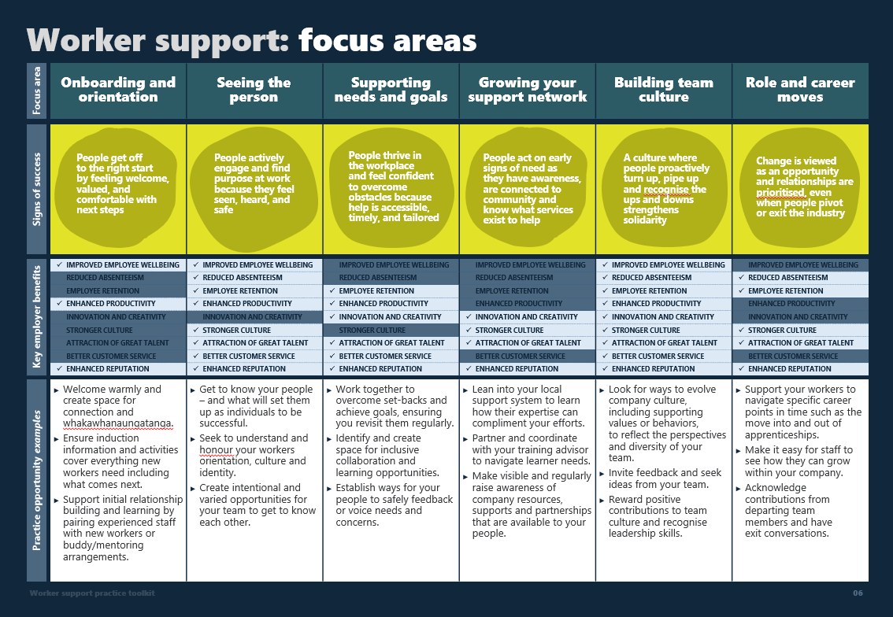
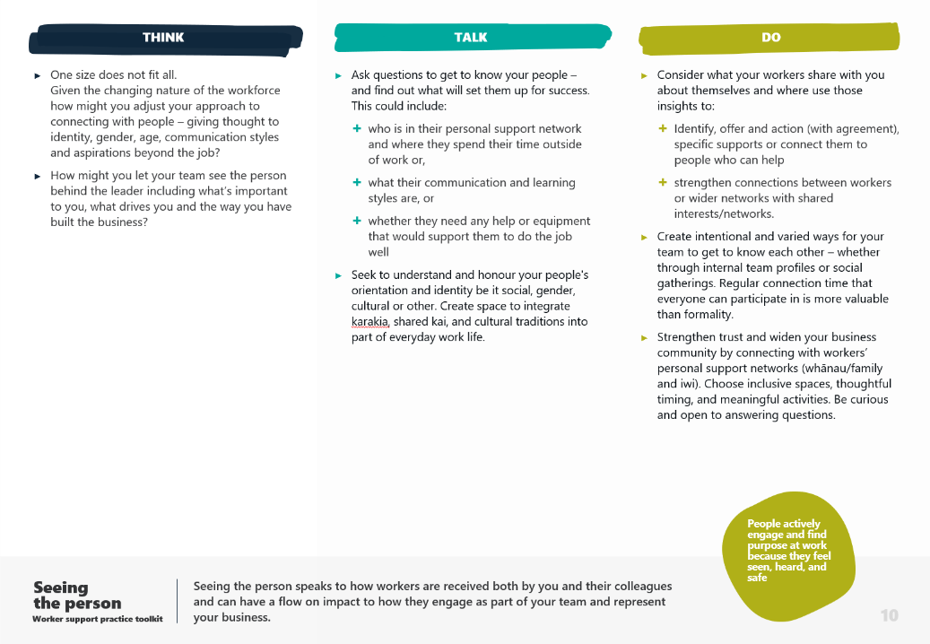

What can you
do right now?
1. Practice focus areas
  Six focus areas are introduced that describe points in a worker’s typical experience with an employer where worker supports will have the most impact.
  Onboarding and orientation
  Seeing the person
  Supporting needs and goals
  Growing your support network
  Building team culture
  Role and career moves
      Each of the focus areas above have a description
      of what good looks like alongside some high level practice examples. The framework can be used as
      a starting point to prompt thinking about where your company has strong practice and where the gaps might be. See page 22 for a more comprehensive list.
  2. Practice ideas
  Each of the focus areas have a dedicated page
  to describe practical ideas in more detail.
  These ideas sit in buckets that align with the scale
  of effort to do them, for example, from things
  you might consider thinking about or raising with the team through to bigger actions that need more time.
  Some of the practice initiatives feature guidance
  or templates you can use for thought starters.
Your company’s approach to supporting your people will look different from others and that’s okay. It will depend
on things like:
  how well you understand what worker support means
  where you're based
  the makeup of your team (age, gender, culture, ability, experience), and
  the time, tools, and resources you have on hand.
What’s in the next few pages to help:
  Practice focus areas: A one-page overview of key focus areas – a simple way to see where change
  can happen.
  Practice ideas: examples
  of actions you can take now.
THINK
  Things to reflect on
  Things to ask or raise
  with your team
  Things you can action
  or invest in
TALK
DO
The following pages (7-22) have been designed for you to place your logo
on or extract and adapt content as
you need it.
06

Slide 9
Construction and Infrastructure sector:
Worker support
practice toolkit
Keep it simple.
Keep it human.
Keep it up.
[ Insert your company name/logo ]
[ Insert Date ]

Slide 10

Worker support focus areas
Focus area |  | Onboarding and orientation | Seeing the person | Supporting needs and goals | Growing your support network | Building team culture | Role and career moves
Signs of success
Key employer benefits |  | People feel better at work | People feel better at work | People feel better at work |  | People feel better at work
 |  | People show up more often | People show up more often | People show up more often |  | People show up more often | People show up more often
 |  |  | Workers stick around longer | Workers stick around longer |  | Workers stick around longer | Workers stick around longer
 |  | More work gets done | More work gets done | More work gets done |  | More work gets done
 |  |  |  | New ways of doing things are shared | New ways of doing things are shared | New ways of doing things are shared
 |  |  | People are connected, the culture is strong & healthy |  | People are connected, the culture is strong & healthy | People are connected, the culture is strong & healthy | People are connected, the culture is strong & healthy
 |  |  |  | Customers experience great service |  | Customers experience great service
 |  | Good people want to work with & for you | Good people want to work with & for you | Good people want to work with & for you | Good people want to work with & for you | Good people want to work with & for you | Good people want to work with & for you
Practice opportunity examples |  | Welcome warmly and create space for connection and whakawhanaungatanga. Ensure onboarding information and activities cover everything new workers need to know including what comes next. Support initial relationship building and learning by pairing experienced staff with new workers or buddy/mentoring arrangements. | Get to know your people – and what will set them up to be successful. Seek to understand and honour your worker’s orientation, culture and identity. Create a variety of intentional ways for your team to get to know each other. | Work together to overcome set-backs and achieve goals, ensuring you revisit them regularly. Identify and create regular ways for your team to collaborate and learn together. Set up ways for your people to safely feed back or voice needs and concerns. | Lean into your local support system to learn how their knowledge and skills can complement what you do for your team. Partner and coordinate with your training advisor to navigate learner needs. Make visible and regularly raise awareness of company resources, supports and partnerships that are available to your people. | Look for ways to grow company culture – including values or behaviors that reflect your people, their experience and viewpoint. Invite feedback and seek ideas from your team. Reward positive contributions to team culture and recognise leadership skills. | Support your workers to navigate specific career points in time such as the move into and out of apprenticeships. Make it easy for staff to see how they can grow within your company. Acknowledge valuable input departing team members have made and make sure to have a chat to them about the why and what next.
People get off
to the right start
by feeling welcome, valued, and comfortable with next steps
People connect
and find purpose
at work because they feel seen, heard, and safe
People thrive in
the workplace
and feel confident to overcome challenges because getting help is easy, timely, and right for them
People act on early
signs of need as
they have awareness, are connected to community and
know what services exist to help
A culture where people proactively turn up, pipe up and recognise the ups and downs strengthens solidarity
Change is viewed
as an opportunity and relationships
are positive, even when people pivot
or exit the industry
08

Slide 11
THINK
TALK
DO
  How do you as a leader invest in new starter relationships and ensure they get a warm welcome?
  How do you ensure your people understand the importance of their role and skills within your company?
  Alongside technical skills what workforce ready or transferrable skills do you consider key to the success of your people and business, for example, time management or problem solving.
          How could your induction process quickly show where new starters have gaps and help to close them?
  Exposure and learning can go both ways. Think about the value and importance of a buddy/mentoring arrangement for workers to connect, experience positive role modelling and come up to speed quickly. Identify who would be best placed to be involved.
  Returning from leave whether from injury, parental leave or a mental health break are critical moments, that alongside being new
  to work, need to be treated with care. Think about how you remain connected to your worker during their time away and what a return to work plan could look like.
  Check in on new starters before their first day, even if it’s a quick phone call to let them know where to be and what they can expect to be doing in their first few days with you.
  Ask your team what key information, resources and equipment they found helpful when they first started to keep onboarding practice up-to-date.
  Ask your team how you can create space for whakawhanaungatanga and connection on day one for new starters and during the onboarding process.
  Get to know any outside of work commitments your new starters have so
  you understand and can plan for flexibility, for example daycare pick ups or netball coaching. Be sure to communicate whether the flexibility you’re offering is a one off or permanent arrangement.
  Talk to your workers and wider network about buddy and mentoring arrangements. Gather ideas about expectations, goals and time commitments to see whether it might be a good fit for your business.
  Develop a checklist to make sure new starters have everything they need on day one. This might look like key information about facilities, equipment or where/who
  to seek further guidance from.
  Capture and share with your new starter a high level week by week plan to ensure they know what comes next.
  Integrate key workforce ready or transferrable skills that are important to your business into the induction learning process, for example time management skills.
  Establish a buddy/mentoring process or support relationship building and initial learning through small team structures, pairing experienced staff with new workers.
  Write it all down – capture and organise key information about your people, agreements and processes and follow up.
People get off
to the right start
by feeling welcome, valued, and comfortable with next steps
Onboarding
and orientation
  First impressions count - new starters only ever have one first day/week with you.
  Who they’re guided by and what they experience during this time can often confirm for them
  that they’re in the right place, have made a good decision and have a lot to look forward to.
Worker support practice toolkit
09

Slide 12

THINK
TALK
DO
  One size does not fit all. Given the changing nature of the workforce how could you adjust your approach to connecting with people – thinking about identity, gender, age, communication styles and aspirations beyond the job?
  How could you let your team see the person behind the leader including what’s important to you, what drives you and the way you have built the business?
  Ask questions to get to know your people – and find out what will set them up for success. This could include:
          who is in their personal support network and where they spend their time outside of work or,
          what their communication and learning styles are, or
          whether they need any help or equipment that would support them to do the job well.
  Seek to understand and honour your peoples’ orientation and identity, be it social, gender, cultural or other. Create space to integrate karakia, shared kai, and cultural traditions into part of everyday work life.
  Consider what your workers share with you about themselves and where to use those insights to:
          identify, offer and action (with agreement), specific supports or connect them to people who can help, and
          strengthen connections between workers or wider networks with shared interests/networks.
  Create intentional and varied ways for your team to get to know each other – whether through internal team profiles or social gatherings. Regular connection time that everyone can participate in is more valuable than formality.
  Strengthen trust and widen your business community by connecting with workers’ personal support networks (whānau/family and iwi). Choose inclusive spaces, thoughtful timing, and meaningful activities. Be curious and open to answering questions.
Please see a companion guide
“ Apprenticeship toolkit” for effective ways to recruit, connect, and work specifically with apprentices.
People connect
and find purpose
at work because they feel seen, heard, and safe
Seeing
the person
  Seeing the person speaks to how workers are received both by you and their colleagues
  and can have a flow on impact to how they engage as part of your team and represent
  your business.
Worker support practice toolkit
10

Slide 13

EXAMPLE
DO
  PRACTICE RESOURCE: learning about your people question sheet
  TIMING: 2-3 hours
  WHO: Employer or lead and new starter
  PROCESS:
  Print off the template and change
  content where it needs to be more local and immediate to your region, company
  and people.
  Take the time to discuss with a new starter why this activity is important, what the questions mean and what you’ll do with the information. Let them ask questions and tell you how they’d like to complete it. For example, people may want to talk about it while others might like to write or draw their responses.
  Provide a timeframe for them to complete it by and book in the next meeting to follow up.
  Once you receive the new starter’s response take the time to review its content and make note of things you’d like to capture, know more about or offer to help with.
  HOW TO USE IT:
  Based on the points you’ve noted, discuss
  with your new starter what care or extra supports are available to help them.
  For example during the winter they have rugby practice on Thursday nights on the other side
  of town – you might suggest a flexible working arrangement for the season.
  How you got here: What led you to this role and what did the journey look like to get here?
  Role goals/aspirations: What does success look like for you over the next 6 months?
  Challenges: what barriers or challenges do you have that might present in the workplace that you’re comfortable to share (current or pending).
I want to learn more about interior vs exterior plastering so I can decide what I’m best at.
I want to do a good job so the team trust me to do the bigger jobs with them.
None that I can think of. I do live quite far from work so if I miss the bus there isn’t another one for an hour.
My uncle – had me helping with plastering for his house renos. Then did a course at Polytech where you got to try a few different trades. Still liked this one the best though!
Jacob Torrens
NAME
NICKNAME
ROLE
  Needs: what support, equipment or resources do you need to be able to work well and thrive?
  What does stress look like on you and what do you find helps?
Jake
Can’t think of anything
  Interests: how do you like to spend your time outside of work?
  What does relaxing look like for you?
Level 1- plasterer
Hang out with my mates
and I’m learning how to weld
at the moment
I can be a bit quiet I guess
Hanging out with my mates,
River swims and watching
a movie with my girlfriend
  Commitments: what regular priorities or obligations do you have outside of work that would be useful for me to know?
  Your “go to” people: Who are the people you value and go to for support?
  Communication and learning: how you like to engage with people and learn?
I like to see videos of people doing what I’m trying to do
My mum, uncle Tom and aunt Rahera. My girlfriend Tia.
My rugby mates (most of them
I know through school)
Rugby practice
Remember if you spot something
that needs addressing, ask yourself:
What can I do?
What guidance do I need?
Who can I connect with
who can help?
Seeing
the person
Worker support practice toolkit
11

Slide 14

  How you got here: What led you to this role and what did the journey look like to get here?
  Role goals/aspirations: What does success look like for you over the next 6 months?
  Challenges: what barriers or challenges do you have that might present in the workplace that you’re comfortable to share (current or pending).
NAME
NICKNAME
ROLE
  Needs: what support, equipment or resources do you need to be able to work well and thrive?
  What does stress look like on you and what do you find helps?
  Interests: how do you like to spend your time outside of work?
  What does relaxing look like for you?
CHOOSE A PHOTO THAT SHOWS YOU IN A MOMENT YOU’RE PROUD OF OR WITH PEOPLE YOU LOVE OR ADMIRE
  Commitments: what regular priorities or obligations do you have outside of work that would be useful for me to know?
  Your “go to” people: Who are the people you value and go to for support?
  Communication and learning: how you like to engage with people and learn?
Seeing
the person
Insert your company name/logo
Worker support practice toolkit
12

Slide 15
THINK
TALK
DO
  What channels do you have for people to easily and safely feed back or voice needs
  and concerns? How can you remind people what they are and how/when they can be accessed?
  Are there leadership or dedicated support roles in your company where responsibilities and commitment to the team could be clearer? For example, are you the “go to” person for wellbeing support and are you available outside working hours?
  When challenges are raised ask yourself, what can I do to help? As a leader, where
  do I need additional or specialist support?
  Who can I ask for help?
  Equally when opportunities are raised ask yourself, what can I do to support this person? Do I need additional or specialist guidance? Who can I connect
  with to help?
  Make checking in with your people to see how they’re doing a regular practice regardless of whether there’s something specific to address. Being present and taking an interest in people builds trust and comfort in seeking your guidance should they need it in the future.
  Aim to have one-on-one conversations about goals, set-backs or challenges in surroundings that are familiar to your people to level the power balance. For example, talking about a challenging job is likely to be easier if a worker is in an environment they know or feel comfortable in.
  Work together to come up with plans to overcome set-backs or achieve goals. Ensure you discuss with your people the options and agree what comes next and when.
  Identify and create space for collaboration and intentional learning opportunities, ensuring your people understand the value purpose and commitment you’re asking
  of them.
  Take time to check progress and revisit goals that have been set by your team. Follow-through is what counts to help people succeed and maintain trust.
  Create ceremony and recognise achievement (big and small) acknowledging people start from different places.
  Turn good practice into business knowledge to make sure momentum isn’t lost.
  For example, by capturing collaboration techniques that worked or recording goal planning processes or checklists.
If you see an opportunity to connect your worker to external support, for example a budgeting advisor service, ensure you raise it with them and get agreement
on it as a step they want to take.
People thrive in
the workplace
and feel confident to overcome challenges because getting help is easy, timely, and right for them
Supporting needs and goals
  Being available and consistently connecting and working alongside your people to support them shows you value their contribution to the role, the culture and your wider business.
Worker support practice toolkit
13

Slide 16
THINK
TALK
DO
  What are the most common concerns and needs your people have and is there a pattern? How could you proactively address these things before they happen or when they happen, address them quickly?
  Consider who sits in your support system. Research and reach out to people, community or service providers to learn
  how their knowledge and approach can complement what you do for your team.
  Connect with your team and discuss what care and support means and looks like for your people, in your region and line of work.
  Keep company and external resources and delivery partnerships visible – referring to them often so people know what options there are for support and how to access them.
  Provide information, promote discussion
  and empower your staff – so that they can recognise the signs that someone might need assistance and know what to do.
  Make peer networks visible and encourage participation.
  Connect and coordinate with training advisors – to help you navigate learner needs alongside supporting learning plans and training.
  Explore relationships with local iwi, church groups or community networks, especially where workers have established connections.
People act on early
signs of need as
they have awareness, are connected to community and
know what services exist to help
Growing your support network
  You don’t have to do this alone. Knowing about resources, local services and people
  that can help with your team’s specific needs or goals means that when the time
  comes you can connect faster.
Worker support practice toolkit
14

Slide 17
EXAMPLE
DO
  REAP Aotearoa
  Education unlimited
  Literacy Aotearoa – Alice Chambers
  PRACTICE RESOURCE: Your support system
  TIMING: 1hr and ongoing
  WHO: Employer, HR, Leadership team and don’t forget
  to ask your employees
  PROCESS:
  Write down a list of all the people, services or resources in your wider network that you’d seek help from or use for supporting your people.
  This could be an industry mate, the Are You Ok? online resources or a service like Healthline.
  There’s no right or wrong answer.
  Print off the template on the next page (or draw your own) and write in the spaces provided categories that make sense to you that the list
  could be split into, for example,
          support subject matter: mental health, literacy, disability support
          channels: print/digital resources, key people, professional or Government services
    Read and transfer the people, services and resources you’ve come up with into the categories they align
    most to.
  HOW TO USE IT:
  Looking at your map can you see:
  any gaps that you may need to research, and fill based on what your people come to you for?
  are there people you’ve lost touch with or services you don’t know how to access?
  Make a note of what you need more of and
  make it a regular habit to backfill this map. When
  a worker needs assistance that’s outside your area
  of expertise you can call on it quickly to see what
  your next steps will be. If it evolves into a support directory for your team, even better!
  BCITO – modules
  Acknowledging and practicing cultural awareness
  Raukawa
  Whanau Ora
  Whakarongorau/ Telehealth Vitae Counselling
  Depression.org
  Healthline
  EmployerLine NZ
  Waimarino HapuOra
LEARNING + NEURODIVERSITY
-
-
MENTAL HEALTH + WELLBEING
MIGRANT SUPPORT
1
2
6
  English Language Partners
  John at Welcoming Communities (Stephs contact)
  JC Plumbing
  Ka Puta Ka Ora Emerge Aotearoa
  Workbridge.co.nz (workplace design and modifications)
  NZCL Community Health Service
  Support
  system
3
5
DISABILITY SERVICES
YOUTH SUPPORTS
4
  Pasifika for Tomorrow – Faatili foe mo le a’e
  Steve Caspers – Camp TrekMate
  Pathways.co.nz
  Youthservice.govt.nz
  Mission Nutrition – Anne (Marlows uncle)
  Outward Bound – Andrea Smart (scholarship contact)
MONEY/FINANCE
If managing pay, bills or
costs week by week is something you’ve seen your team struggle with, consider bumping up the resources or supports you
have here…
  Citizens Advise Bureau – Kahu Williams (our local advisor)
Growing your support network
Worker support practice toolkit
15

Slide 18
1
6
1
2
5
2
6
  Support
  system
3
5
4
3
4
Growing your support network
Insert your company name/logo
Worker support practice toolkit
16

Slide 19
THINK
TALK
DO
  What ways are you showing the values and behaviour you want to see in others at work? Are there any behaviours you can leave behind and some you’d like to show more of?
  Is your company culture reflective of the diversity and perspective your people bring to the table? What might a culture 2.0 look like if you could stop some things, start some things and keep the good practice?
  Reflecting on how and who you’re hiring, are you bringing in the right mix of diversity and skills to grow your team and support your business?
  Providing opportunity for the team to contribute to business or culture change can create a sense of ownership, accountability and achievement. Let your people know what company processes are fixed and where ideas or feedback are welcome.
  Invite workers to share aspects of their culture that are important to them to create shared understanding including engaging with
  Te Ao Māori and Pacific concepts of wellbeing.
  Proactively talk with your people about communication styles and preferences to understand:
          how to play to their strengths, and
          how you might agree to resolve disagreements when they arise.
  Serious safety incidents, restructures, or community events can have a big impact on morale. Show up for affected workers quickly – ensuring they have the time, people and supports they need to help process the situation. You don’t have to have all the answers, but you do need to create the space for your people to ask questions.
  Invest in the team culture with intentional opportunities for team building and social events where everybody is welcome and can participate.
  Reward positive contributions to team culture and make a point of recognising when staff model leadership.
A culture where people proactively turn up, pipe up and recognise the ups and downs strengthens solidarity
Building
team culture
  Cultures are built through shared experience and meaning. Encouraging people to regularly connect, collaborate and contribute in ways that acknowledge their skills, and perspective instils trust and makes them feel like part of a team.
Worker support practice toolkit
17

Slide 20



DO
Share and discuss behaviour based stories.
Repeat for each team member and write down the things that were discussed.
This was difficult…,
because
of this behaviour….
this is what could have
been done differently….
Key idea, behaviour
or phrase
  PRACTICE RESOURCE: Team commitment/
  charter guide
  TIMING: Team work – 2 hours (based on team of 10)
  Refining – 3 hours (based on someone taking the lead to craft the final)
  WHO: Leader and team
  PROCESS:
  Give a heads up that you want your team to create a charter together and what the process is going to be.
  Gather your team in a familiar environment, ensuring everyone can participate.
  Discuss the purpose and why a charter is valuable and how it will be used. Create a safe space for discussion.
  Ask people to think about and share with the group
  a time when they experienced or witnessed a difficult scenario at work and get them to name the behaviours they saw that made it worse.
  Invite the team to discuss each scenario that’s raised and come up with what a better approach may
  have been.
  Capture these key positive ideas, behaviours and phrases on a whiteboard for everyone to see.
  Ask the team to vote on the top 8-10 concepts they want each other to show in your workplace.
  Discuss how you might like to see the charter used and what it might look like.
  A lead then takes the ideas away to turn the teams thinking into a charter that reflects what they value.
  HOW TO USE IT:
          Use it to onboard new team members.
          Use it to guide decisions and resolve disputes.
          Include it in performance discussions.
Key idea, behaviour
or phrase
Key idea, behavior
or phrase
Looking at all the ideas the teams come up with, ask people to vote for the ideas that feel right for them and the team culture.
Key idea, behaviour or phrase
Key idea, behaviour
or phrase
Key idea, behaviour or phrase
Key idea, behaviour
or phrase
Key idea, behaviour
or phrase
Key idea, behaviour or phrase
Key idea, behaviour
or phrase
Key idea, behaviour
or phrase
Key idea, behaviour
or phrase
TEAM
CHARTER
Gather the ideas with the most votes and create your charter.
Key idea, behaviour
or phrase
Key idea, behaviour
or phrase
Key idea, behaviour
or phrase
QUICK TIP: If your people aren’t comfortable talking about scenarios that were challenging simply ask them to recall a positive experience and name those behaviors instead.
Building
team culture
Worker support practice toolkit
18

Slide 21
THINK
TALK
DO
  Can you reflect on a time when you would have appreciated guidance when faced with an important situation or choice you thought you had to keep to yourself?
          How could you make workers feel safe and supported to openly discuss needs and future plans including moves to other companies or trades?
          Could you connect them with people in your network who might be able to provide further guidance or opportunity that is more aligned with their goals and aspirations?
  Have you observed any pre or post resignation signals and trends, or perhaps needs that aren’t currently being met?
          Are there any issues you might be able
          to proactively address before you see
          it again in the future?
  Support workers to navigate the move into and out of apprenticeships, helping them understand expectations of the role, what comes next, and who can provide guidance along the way.
  Make it easy for all workers to see how they can grow within the company. Share your company's structure, what roles exist and why, and what steps they could take to get them.
  Create equal opportunity for progression by being transparent about what roles are available and when, as well as the skills and experience needed to do the job well.
  Invest time in having an exit conversation with departing team members to understand why they’re leaving and what their next steps are. There are opportunities for learning and growth for both parties if a safe space is created to capture feedback. Where appropriate, share learnings with your leadership team to discuss where/if improvements need to be made.
  Acknowledge the contributions of departing team members, take the time to say goodbye and create a comfortable space for the team
  to do so too.
  Write down the offboarding process so
  it can be easily followed next time.
QUICK TIP: Not all departures are appropriate to explain or mark with occasion. Ensure you talk to the person who is leaving to ask how they would like to have their departure acknowledged.
Change is viewed
as an opportunity and relationships
are positive, even when people pivot
or exit the industry
Role and
career moves
  Growth and change is an important and inevitable part of a career path. As an employer, seeing and supporting your people's potential whether that’s within your own company or being the bridge to their next step shows commitment to your relationship and what's in their best interests.
Worker support practice toolkit
19

Slide 22
DO
  PRACTICE RESOURCE: Exit interview questions
  HOW TO USE IT:
  Here are some key questions you can choose to ask workers who are leaving that might give you insight into current company practice that you can address, strengthen or consider starting.
  The questions you ask should be right for
  your people and context and appropriate
  for the person and reason they’re leaving.
  Questions can be raised in conversation
  or through a survey.
  What parts of the job did you enjoy most and why?
  What are you most proud
  of achieving here?
  Were there any specific challenges or obstacles you faced during your time here?
  Were there any tools, systems, or processes that helped you or got in your way?
  Did you feel your skills were being used well?
  How well did the training and learning opportunities meet your needs and expectations?
  How well did you feel supported by your team
  and leaders?
  What else could we have done to keep you feeling more supported?
  How would you describe the culture on site or in the office?
  What advice would you give to new people joining our team?
  Is there anything you’d like to raise that we haven’t covered that is important to share?
  The most important thing to do is create
  a safe space for sharing, listen carefully and capture the responses to support
  any change that needs to be made.
Role and
career moves
Worker support practice toolkit
20

Slide 23
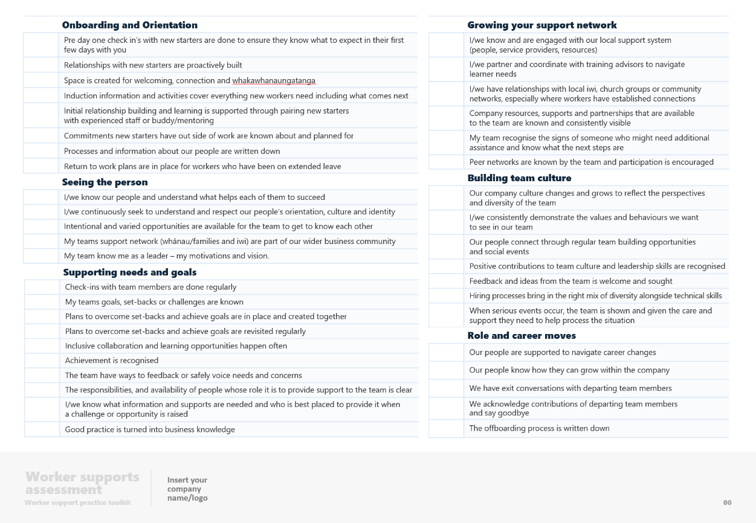
EXAMPLE
DO
  PRACTICE RESOURCE: foundational
  worker supports assessment
  TIMING: 2 hours+
  WHO: Employer and/or Leadership team
  PROCESS:
  Read through the list and in the column next
  to each point give yourself a rating on a scale from 1-5 to indicate whether you think your company demonstrates:
  Limited practice…….……...………....…. 1
  Some practice ……….……………………. 2
  Some good practice………………....….. 3
  Good practice…………………………...…. 4
  Great practice …………………………...…. 5
  HOW TO USE IT:
  Once you’ve finished reflect on the areas where you’ve rated 1-3.
  This is not a formal evaluation of how advanced you are in providing good care
  and support to your people. What it is, is
  an opportunity to reflect and see where the
  gaps are so that when you’re ready you
  know where to focus new thinking or practice.
  If nothing else, we encourage you to…
See the next page
for this template
Role and career moves
3 | Our people are supported to navigate career changes
2 | Our people know how they can grow within the company
4 | We have exit conversations with departing team members
5 | We acknowledge contributions of departing team members and say goodbye
4 | The offboarding process is written down
Is this relevant to your team and the size of your business?
Shed some light on the types of roles and skills
they might want to have set in their sights for the future.
Keep it up!
Keep it simple.
Keep it human.
Keep it up.
21

Slide 24
Onboarding and Orientation
 | Pre day one check in’s with new starters are done to ensure they know what to expect in their first few days with you
 | Relationships with new starters are proactively built
 | Space is created for welcoming, connection and whakawhanaungatanga
 | Induction information and activities cover everything new workers need including what comes next
 | Initial relationship building and learning is supported through pairing new starters with experienced staff or buddy/mentoring
 | Commitments new starters have outside of work are known about and planned for
 | Processes and information about our people are written down
 | Return to work plans are in place for workers who have been on extended leave
Growing your support network
 | I/we know and are engaged with our local support system (people, service providers, resources)
 | I/we partner and coordinate with training advisors to navigate learner needs
 | I/we have relationships with local iwi, church groups or community networks, especially where workers have established connections
 | Company resources, supports and partnerships that are available to the team are known and consistently visible
 | My team recognise the signs of someone who might need additional assistance and know what the next steps are
 | Peer networks are known by the team and participation is encouraged
Seeing the person
 | I/we know our people and understand what helps each of them to succeed
 | I/we continuously seek to understand and respect our people's orientation, culture and identity
 | Intentional and varied opportunities are available for the team to get to know each other
 | My team’s support network (whānau/family and iwi) are part of our wider business community
 | My team knows me as a leader – my motivations and vision.
Building team culture
 | Our company culture changes and grows to reflect the perspectives and diversity of the team
 | I/we consistently demonstrate the values and behaviours we want to see in our team
 | Our people connect through regular team building opportunities and social events
 | Positive contributions to team culture and leadership skills are recognised
 | Feedback and ideas from the team is/are welcome and sought
 | Hiring processes bring in the right mix of diversity alongside technical skills
 | When serious events occur, the team is shown and given the care and support they need to help process the situation
Supporting needs and goals
 | Check-ins with team members are done regularly
 | My team’s goals, set-backs or challenges are known
 | Plans to overcome set-backs and achieve goals are in place and created together
 | Plans to overcome set-backs and achieve goals are revisited regularly
 | Inclusive collaboration and learning opportunities happen often
 | Achievement is recognised
 | The team have ways to feed back or safely voice needs and concerns
 | The responsibilities, and availability of people whose role it is to provide support to the team is clear
 | I/we know what information and supports are needed and who is best placed to provide it when a challenge or opportunity is raised
 | Good practice is turned into business knowledge
Role and career moves
 | Our people are supported to navigate career changes
 | Our people know how they can grow within the company
 | We have exit conversations with departing team members
 | We acknowledge contributions of departing team members and say goodbye
 | The offboarding process is written down
Worker supports assessment
Insert your company name/logo
Worker support practice toolkit
22

Slide 25


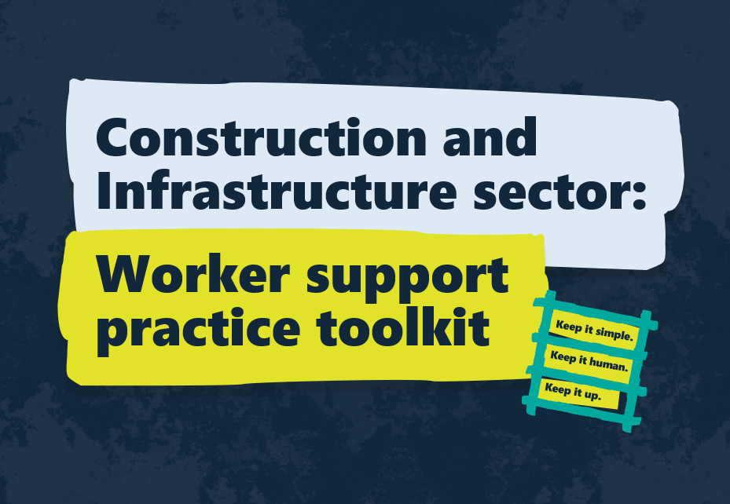



About this toolkit
This toolkit was developed by Waihanga Ara Rau and ConCOVE Tūhara to help employers in the New Zealand construction and infrastructure sector build stronger, more resilient teams through practical support.
It’s based on what people in the industry told us works, and where things are harder to focus. We talked to employers and training advisors to understand the everyday realities on site and on the job.
From those insights, we pulled together real-world, practices that help employers overcome common challenges – things like staff retention, training drop-offs, and how
to support workers through tough times.
Looking ahead
The Worker Support toolkit is part of a wider set of artefacts building on a synthesis of sector knowledge. Three documents have been produced to capture the research, insights, and impacts at different levels across the sector, including considerations for what comes next.
An Insights Report that explores current capability gaps and system-level barriers to providing effective worker support at scale as well as introducing six priority areas for change.
And a broader roadmap for the sector, which outlines actions at every level – from industry to government, to improve the level of support employers receive to do their job well.
As part of the roadmap, we’ve recommended that a formal definition and sector-wide framework be developed. That would help keep care, wellbeing, and workforce sustainability front and centre across the whole system.

Slide 26
Construction and Infrastructure sector:
Worker support practice toolkit
Keep it simple.
Keep it human.
Keep it up.
SEP 2025

